Slide 1














Project Presentation
Presented by Group - 03
Bhargav Raman - Ratnango Ghosh - Rishabh Kumar - Vaibhav Gupta

Slide 2
Audio Stem Splitter
Leveraging MUSDB18 and Cutting-edge Deep Learning Architectures

Slide 3
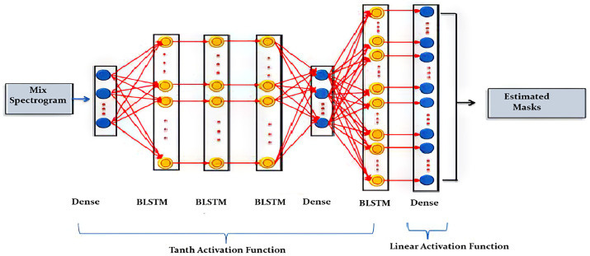
Introduction
Key Points:
What is Source Separation?
Technique to extract distinct elements (e.g., vocals, instruments) from composite audio.
Critical for transcription, restoration, and remixing.
Challenges in Source Separation:
Polyphonic music has overlapping spectral components.
Requires high precision to preserve timbral and rhythmic characteristics.
Relevance of AI:
Advances workflows with precision and creativity.
AI-driven models outperform traditional methods.
Applications:
Professional music production, music education, remixing workflows.

Slide 4
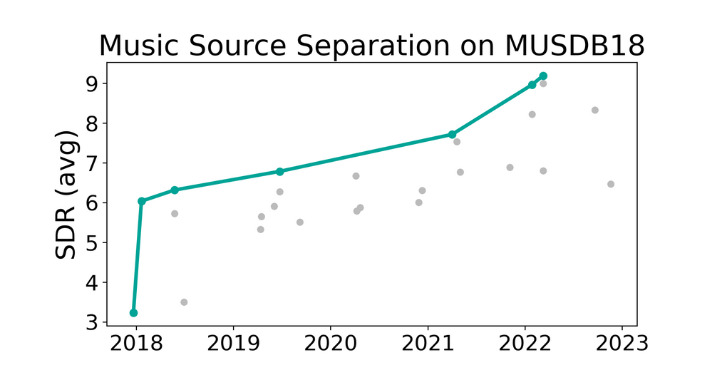
Datasets Overview
Key Datasets:
MUSDB18:
150 tracks categorized into vocals, drums, bass, and others. (10 hours of music)
High-quality annotations and consistent mixing styles.
There also Exists of a MUSDB18-HQ with Uncompressed .wav
DSD100:
Professional tracks from the Mixing Secrets Library.
Consists of around 100 tracks
Supplementary for robust testing and model evaluation.
Dataset Properties:
High sampling rates (44.1 kHz).
Diversity in musical genres and styles.
Future Datasets:
Include culturally diverse music, unique timbres, and live recordings.
MUSDB18-HQ with a higher prediction probability due to it higher bandwidth

Slide 5

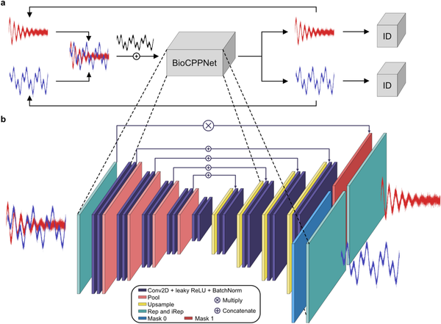
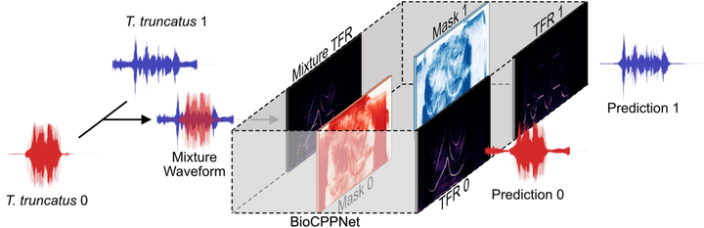
Demucs
SepFormer
Features: Encoder-decoder with LSTM for capturing temporal dependencies.
Performance: SDR of 7.6 dB for bass separation.
Features: Transformer architecture with intra-/inter-chunk attention.
Strengths: Effective in overlapping frequencies and harmonic separation.
Key Architectures
CNN Model
Hybrid Methods:
Features: Low latency with vertical/horizontal convolutions for real-time applications.
Combining waveform and spectrogram-based techniques for better results.

Slide 6
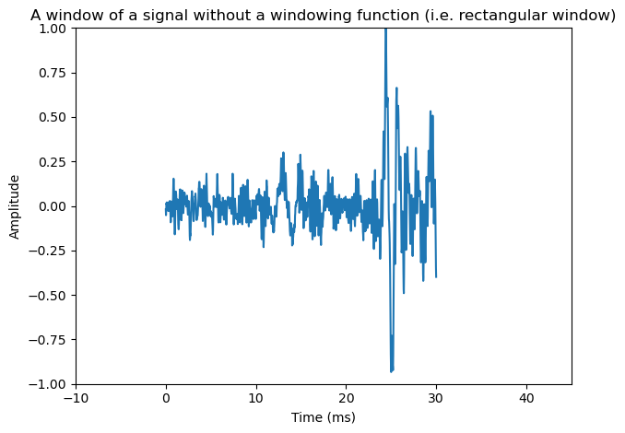
Preprocessing Techniques
Key Methods:
STFT: Converts time-domain audio into frequency-domain spectrograms.
Data Augmentation:
Pitch and tempo shifting to simulate diverse audio conditions.
Adding noise and reverberation for real-world challenges.
Importance of Preprocessing:
Ensures robustness of models across varied musical styles and recording conditions.

Slide 7
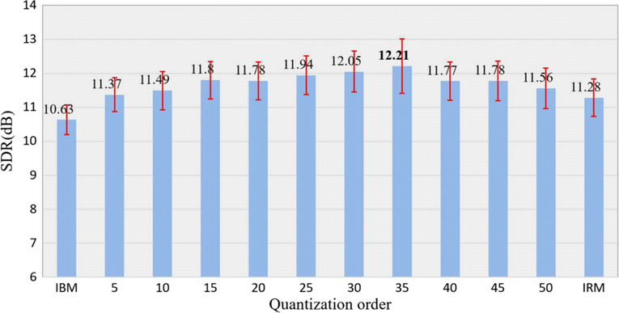
Training and Evaluation Metrics
Training
Evaluation Metrics
Models trained using optimizers (Adam, AdaDelta) with learning rate decay.
Audio chunking (10–30 seconds) for continuous processing.
Epochs: 30–100 depending on convergence.
Pitch/tempo augmentation.
Run this with validation in order to check that the model does not overfit on one musical track instead of trying to split it for all music possible
Models are trained by setting weights across each epoch and updating those as the model moves on
Signal-to-Distortion Ratio (SDR): Measures separation quality.
Source-to-Interference Ratio (SIR): Assesses interference in separated tracks.
Source-to-Artifact Ratio (SAR): Evaluates artifact presence in outputs.
Forwarding Loss is applied for each second of track to see if it fits the audio. If it is considered an error it gets added up and squared.
Since this music is tested and appended at every second, the music has to be stitched at the end to try and provide a final product

Slide 8
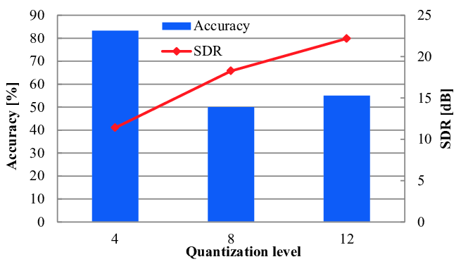
Results and Achievements
Performance Highlights:
Demucs Model:
The Demucs model surpassed oracle benchmarks, especially in bass separation. Its ability to accurately isolate low-frequency components from complex audio sources sets it apart as a highly effective tool for audio separation tasks.
CNN Model:
The CNN-based model excelled in low-latency performance, making it well-suited for real-time audio applications where processing speed is crucial for seamless operation.
Validation on DSD100:
Both models were extensively validated on the DSD100 dataset, which ensured their ability to generalize effectively across a wide variety of audio source types.
Audio Splitting Accuracy:
The models achieved a solid 54% accuracy in audio source separation, highlighting their potential while indicating areas for further refinement.
Statistical Analysis:
Significant improvements in Signal-to-Distortion Ratio (SDR) were observed, with gains ranging from 6.3 to 7.6 dB. This indicates a marked reduction in distortion and better overall separation quality, ensuring more precise and natural audio outputs.

Slide 9
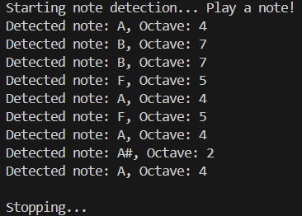
Finding Musical Notes
Using the Zeroth Octave for musical notes, we can find the the frequency of the notes in the next octave.
The relation between Note X in Octave n vs Note X in Octave (n+1) is:
Frequency of X (n+1) = 2 . Frequency of X (n)
The Frequencies of the 0 octave (in Hz) were found as:
C0 = 16.351 C#/Db = 17.324
D = 18.354 D#/Eb = 19.445
E = 20.601
F = 21.827 F#/Gb = 23.124
G = 24.499 G#/Ab = 25.956
A = 27.5 A#/Bb = 29.135
B = 30.868
For Example: C = [C0,C0*2,C0*4,C0*8,C0*16,C0*32,C0*64,C0*128,C0*256,C0*512]

Slide 10
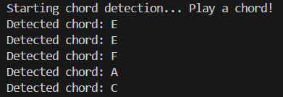
Finding Chords
Unlike Notes, Chord Progressions need the Frequency of all its constituent Notes which may not all be in the same Octave. Hence, there is a need to manually assign some of these
'A': [82.41, 110.00, 164.81, 220, 277.18, 329.63]
'Am': [82.41, 110.00, 164.81, 220, 261.63, 329.63]
'C': [83, 127, 160, 197, 258, 329]
'D': [82.41, 110.00, 146.8, 220, 293.66, 370.00]
"E": [82.4, 123.5, 164.8, 208.5, 246.9, 329.6]
"Em": [82.4, 123.5, 164.8, 196, 246.9, 329.6]
'G': [98, 123.00, 146.83, 196, 246.94, 392]
'F': [87.31, 130.00, 174.6, 220, 261.6, 349.23]

Slide 11
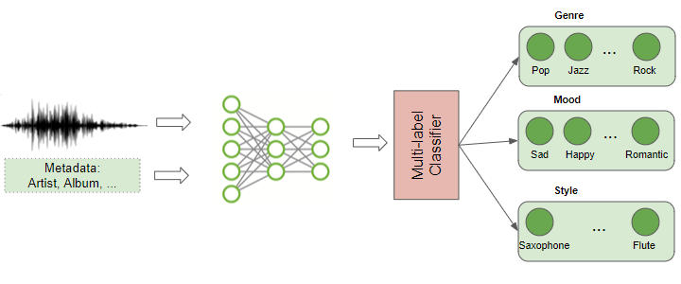
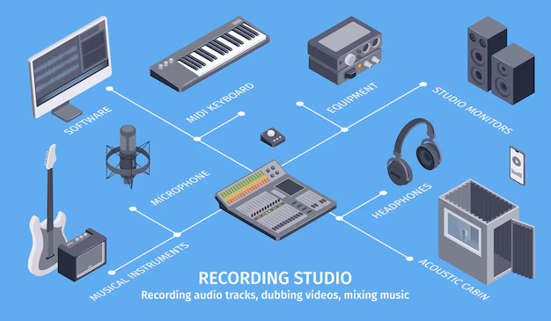
Applications
Key Uses:
Music remixing and production.
Live audio processing.
Automatic music transcription (AMT).
Potential Areas:
Music education and real-time performance.
Broader datasets to include global music diversity.

Slide 12

Challenges and Limitations
Challenges:
Dataset limitations: Predominantly Western music, lack of cultural diversity.
Computational constraints: Models require significant CPU Resources
Audio artifacts: Challenges in separating less distinct components.
Size of Dataset is large
Future Directions:
Improving accuracy by running on the larger test model
Lightweight models for real-time processing.
Tending towards a larger number of instruments for learning

Slide 13
Conclusion
Key Takeaways:
Significant advancements in AI-driven source separation.
Importance of diverse datasets and hybrid techniques.
Future opportunities in lightweight architectures and global music inclusion.
AI is bridging creativity and precision in music."

Slide 14
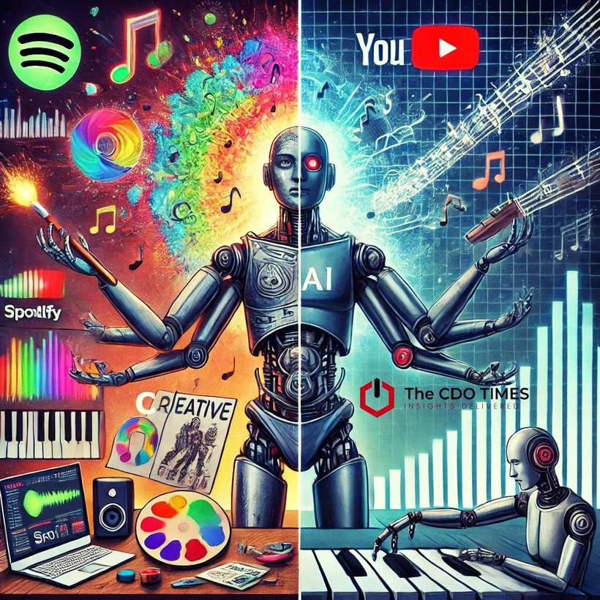
References:
Cited Links:
MUSDB18: https://sigsep.github.io/datasets/musdb.html
GitHub: https://github.com/SConsul/audio-source-separation
Conference Proceedings : https://link.springer.com/book/10.1007/978-3-319-53547-0
MakersPortal Articles:
Recording Audio
Audio Processing - Part II
Audio Processing - Part III

Slide 15
Thank you very much!

